Slide 1
PARAPHRASE RECOGNITION (PR)
Authors: Caviglia Matteo
Formenti Sofia Gaia

Slide 2

PAWS DATASET DESCRIPTION
Specific Algorithm and Human Evaluation
Developed by Google Research
Built upon WikiPedia and QQP.
Designed to evaluate deeper language understanding

Slide 3
PAWS DATASET DESCRIPTION
 | Sentence 1 | Sentence 2 | Label
EX 1 | It is present in Asia, in Japan | In Asia, it is present in Japan | Paraphrase (1)
EX 2 | … To Scotland from England | … To England from Scotland | Not a paraphrase (0)

Slide 4
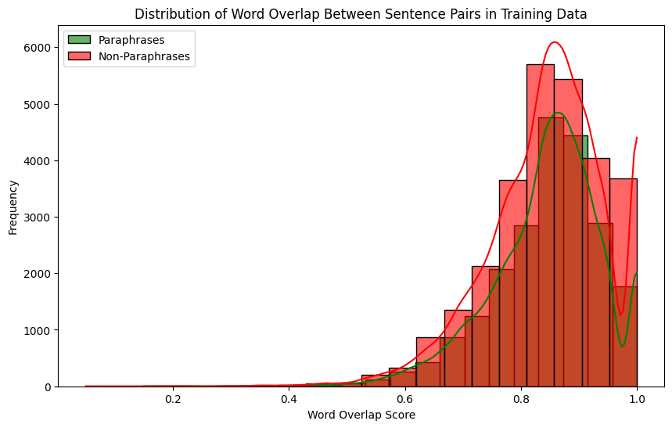

PAWS DATASET DESCRIPTION
ISSUES
SIMILAR STRUCTURE
HIGH WORD OVERLAP
IMPORTANCE OF SEQUENTIALITY

Slide 5
USED MODELS
Roberta + Siamese Network
Bag Of Words
Step 2
Step 4
Step 1
Step 3
DeBERTaV3
Embedding
Layer

Slide 6
1. BAG OF WORDS
COMBINATION
COUNTVECTORIZER
EVALUATE
LOGISTIC REGRESSION
The two sentenced are combined in a single list
Remove stopwords and lowercase
Output accuracy score
Train classifier

Slide 7
1. BAG OF WORDS
As expected, this procedure did not provide great results, due to its inability to properly capture semantic relationships between words, especially because many words overlap in our dataset.
0.523
Test Accuracy

Slide 8
2. EMBEDDING LAYER
Our second chosen method relies on the Embedding Layer provided by the TensorFlow library.
It exploits the concept of learning through training. Basically the embeddings are learned as the Neural Network itself learns.

Slide 9
2. EMBEDDING LAYER
The designed model had to fit the task properly, so we created a double input model that separately processes the two sentences and makes assumptions based on that.
0.601
Test Accuracy

Slide 10
3. ROBERTA + SIAMESE ENCODER
01
02
03
SPECIFIC
PREPROCESS
ROBERTA ENCODER
COSINE SIMILARITIES

Slide 11
3. ROBERTA + SIAMESE ENCODER
Adaptation
Training the encoder
In order to use this model correctly we should have data that has float values ranging from -1 to 1, to best fit the cosine similarity range. In our case we “adapted” this approach to our problem.
In this model we are actually only training the encoder to better represent data. We can see the results of that when calculating the cosine similarities for words before and after the training process.
0.708
Test Accuracy

Slide 12
4. DEBERTAV3
Decoding-enhanced BERT with disentangled attention
Conform dataset to suitable format for BERT-based models
Adam optimizer
Sparse categorical cross entropy loss function for handling raw logits
Model's backbone is set to be trainable, allowing for fine-tuning of the pre-trained DeBERTaV3

Slide 13
4. DEBERTAV3
The last model significantly outperformed the other models. Its enhanced attention mechanisms and the fine-tuning on the PAWS dataset allowed it to capture the details necessary for performing our task properly.
0.933
Test Accuracy

Slide 14
CONCLUSIONS
BAG OF WORDS: 52.3%
EMBEDDING LAYER: 60.2%
ROBERTA+SIAMESE: 70.8%
DEBERTA: 93.3%
As we could have predicted from theory, we had better performances using Transformer-like models rather than standard embedding methods

Slide 15
THANKS
Do you have any questions?
Caviglia Matteo: 513026
Formenti Sofia Gaia: 514495
Please keep this slide for attribution

Slide 16


